Slide 1
A PROJECT ON The Prediction of Liver Disease
Submitted by
SHAIKH NAWAJ YUSUF
Under the Guidance of
Prof. B.K.THORVE
Department of Statistics
Ahmednagar Jilha Maratha Vidya Prasarak Samaj’s
New Arts Commerce and Science College,
Ahmednagar
2018-2019

Slide 2
MOTIVATION
Health is one of the important part of human life.
Doing project which is related to human life is good and important.
which is very beneficial to our community.
I always want to apply machine learning algorithms on real life situation.
There is always an inner desire to use statistical tools practically like R-Studio/Python and see how it works.
Visualisation is much better in R-Studio than any other software.

Slide 3
INTRODUCTION
The liver is one of the important and largest organs of the human body.
The weight of liver is about 1.36 kg and reddish brown in colour.
The liver performs more than 500 functions, such as the production of bile, production of important proteins for blood clotting, purification of blood, helping in fat digestion, decomposing red blood cells and detoxifying harmful chemicals.
Liver disease caused by hepatotropic viruses imposes a substantial burden on health care resources.
The accurate diagnosis of patients is very important in medical science.
Wrong medication may lead to wastage of money and time for the patients, sometimes this may lead to the irreparable loss (death).
One of the fatal diseases that have affected one in five persons of India is liver disease. It is expected that India may become the “world capital” for liver disease by 2025.

Slide 4
INTRODUCTION OF DATA
Data of liver disease taken from ‘Kaggle’ updated in 2017, which is secondary data.
The data contains 583 observations collected from north east of Andhra Pradesh, India. In that, there are 416 individuals are liver patients and remaining 167 individuals are not liver patients. This data contains 441 male patient/not patient records and 142 female patient/not patient records.
Any observation whose age exceeded 89 is listed as being of age “90”.
Link of the dataset :
https://www.kaggle.com/jeevannagaraj/indian-liver-patient-dataset.

Slide 5
In this data there are 11 variables
1) age (Age of an individual)
2) gender (Gender of an individual)
3) tot_bilirubin (Total Bilirubin)
4) direct_bilirubin (Direct Bilirubin)
5) total_proteins (Total proteins)
6) albumin (Albumin)
7) ag_ratio (Albumin and Globulin ratio)
8) sgpt (Alanine Aminotransferase)
9) sgot (Aspartate Aminotransferase)
10) alkphos (Alkaline Phosphatase)
11) Is_patient (It is a binary variable, 1 = Individual is suffering from liver disease Or 0 = individual is not suffering from liver disease)

Slide 6
SUMMARY STATISTICS
Variable | Observations | Obs. With missing data | Obs. Without missing data | Minimum | Maximum | Mean | Std. deviation
Age | 583 | 0 | 583 | 4.000 | 90.000 | 44.746 | 16.190
tot_bilirubin | 583 | 0 | 583 | 0.400 | 75.000 | 3.299 | 6.210
direct_bilirubin | 583 | 0 | 583 | 0.100 | 19.700 | 1.486 | 2.808
tot_proteins | 583 | 0 | 583 | 63.000 | 2110.000 | 290.576 | 242.938
Albumin | 583 | 0 | 583 | 10.000 | 2000.000 | 80.714 | 182.620
ag_ratio | 583 | 0 | 583 | 10.000 | 4929.000 | 109.911 | 288.919
Sgpt | 583 | 0 | 583 | 2.700 | 9.600 | 6.483 | 1.085
Sgot | 583 | 0 | 583 | 0.900 | 5.500 | 3.142 | 0.796
Alkphos | 583 | 0 | 583 | 0.300 | 2.800 | 0.947 | 0.319
Conclusion:-
From the above table, we see that in the liver dataset minimum patient’s age is 4 and maximum patients age is 90 means almost all ages of patient’s are included in this dataset. There is high variation in the Ranges of all other variables.

Slide 7
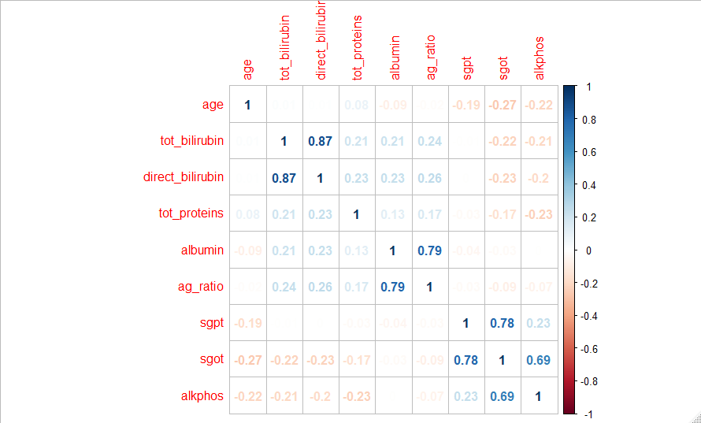
CORRELATION MATRIX
Conclusion : -
all variables are dependent to each others some are positively correlated and some are negatively correlated.

Slide 8
Regression V/s Classification Problem
Variables can be characterized as either quantitative or qualitative (also known as categorical). Quantitative variables take on numerical values. Examples include age, height and temperature. On the other hand Qualitative variables take on values in one of K different classes, or categories. Examples of qualitative variables include gender (male or female), the brand of product purchased (brand A, B, or C) and a patient is suffering from a liver disease (Yes or No).
When response is quantitative then is a regression problems, while those involving a qualitative response are often referred to as classification problems.

Slide 9
Methodology
Binary Logistic Regression
Naïve Bayes classifier
Random Forest
Decision Tree
K – Nearest Neighbour
Support Vector Machine

Slide 10
1) BINARY LOGISTIC REGRESSION
Model 1 includes all the variables
Predictive Model 2 :
Predictive Model 1 :
is_patient = - 4.236 + 0.013008*age - 0.45327*tot_bilirubin + 1.404182*direct_bilirubin + 0.002625*tot_proteins + 0.012213*albumin + 0.00215*ag_ratio + 0.819724*sgpt - 1.60498*sgot + 2.0758*alkphos - 0.04441*isFemale.
 | Estimate | Std. Error | z value | Pr(>|z|)
(Intercept) | -4.236 | 1.257843 | -3.368 | 0.000758
Age | 0.013008 | 0.006072 | 2.142 | 0.032179
tot_bilirubin | -0.45327 | 0.397606 | -1.14 | 0.254291
direct_bilirubin | 1.404182 | 0.768055 | 1.828 | 0.067515
tot_proteins | 0.002625 | 0.000949 | 2.766 | 0.00568
Albumin | 0.012213 | 0.004495 | 2.717 | 0.00658
ag_ratio | 0.002154 | 0.002759 | 0.781 | 0.435058
Sgpt | 0.819724 | 0.347792 | 2.357 | 0.018426
Sgot | -1.60498 | 0.677498 | -2.369 | 0.017837
Alkphos | 2.0758 | 1.037039 | 2.002 | 0.055321
isFemale1 | -0.04441 | 0.220304 | -0.202 | 0.840238
Conclusion : -
We know that p-value of those variables < 0.05 are significant. Therefore age, tot_proteins, albumin, sgpt, sgot are significant.

Slide 11
Confusion Matrix and Statistics
 | Reference
Prediction | 0 | 1
0 | 35 | 59
1 | 6 | 75
Conclusion : -
In the above confusion matrix, out of 175 observations there 35 out of 41 observations and 75 out of 134 observations are correctly classified.
Conclusion : -
From the above table,
i) We see that the accuracy of this model is 62% and it may varies between (55.24%, 70.03%).
ii) Kappa value = 0.2854 means this model fair(means we may use this model for future prediction).
iii) Here Sensitivity is 0.8537 that indicates proportion of non liver patients that were correctly classified to the total no. of non liver patients.
iv) Here specificity 0.5597 that indicates proportion of liver patients that were correctly classified to the total no. of liver patients.
Accuracy | 0.6286
95% CI | (0.5524, 0.7003)
No Information Rate | 0.7657
P-Value [Acc > NIR] | 1
Kappa | 0.2854
Mcnemar’s Test P-Value | 1.12E-10
Sensitivity | 0.8537
Specificity | 0.5597
Pos Pred Value | 0.3723
Neg Pred Value | 0.9259
Prevalence | 0.2343
Detection Rate | 0.2
Detection Prevalence | 0.5371
Balanced Accuracy | 0.7067
‘Positive’ Class | 0

Slide 12
Model 2 made by only significant variables.
 | Estimate | Std. Error | z value | Pr(>|z|)
(Intercept) | -2.27667 | 0.740268 | -3.075 | 0.002102
Age | 0.014412 | 0.005887 | 2.448 | 0.014352
tot_proteins | 0.002984 | 0.000901 | 3.31 | 0.000933
albumin | 0.018029 | 0.003631 | 4.966 | 6.84E-07
Sgpt | 0.324158 | 0.157143 | 2.063 | 0.03913
Sgot | -0.61547 | 0.224271 | -2.744 | 0.006064
Predictive Model 2 :
is_patient = - 2.2767 + 0.014412*age + 0.002984*tot_proteins + 0.018029*albumin + 0.324158*sgpt - 0.61547*sgot.

Slide 13
Confusion Matrix and Statistics
 | Reference
Prediction | 0 | 1
0 | 33 | 48
1 | 8 | 86
Conclusion : -
In the above confusion matrix, out of 175 observations there 33 out of 41 observations and 86 out of 134 observations are correctly classified.
Accuracy | 0.68
95% CI | (0.6054, 0.7484)
No Information Rate | 0.7657
P-Value [Acc > NIR] | 0.9963
Kappa | 0.3337
Mcnemar’s Test P-Value | 1.87E-07
Sensitivity | 0.8049
Specificity | 0.6418
Pos Pred Value | 0.4074
Neg Pred Value | 0.9149
Prevalence | 0.2343
Detection Rate | 0.1886
Detection Prevalence | 0.4629
Balanced Accuracy | 0.7233
‘Positive’ Class | 0
Conclusion : -
From the above table,
i) We see that the accuracy of this model is 68% and it may varies between
(0.6054, 0.7484).
ii) Kappa value = 0.3337 means this model fair(means we may use this model for future prediction).
iii) Here Sensitivity is 0.8049 that indicates proportion of non liver patients that were correctly classified to the total no. of non liver patients.
iv) Here specificity 0.6418 that indicates proportion of liver patients that were correctly classified to the total no. of liver patients.

Slide 14
2) Naïve Bayes classifier
Confusion Matrix and Statistics
Model 1 includes all the variables
 | Reference
Prediction | 0 | 1
0 | 40 | 80
1 | 1 | 54
Conclusion : -
In the above confusion matrix, out of 175 observations there 40 out of 41 observations and 54 out of 134 observations are correctly classified.
Accuracy | 0.5371
95% CI | (0.4603, 0.6127)
No Information Rate | 0.7657
P-Value [Acc > NIR] | 1
Kappa | 0.2269
Mcnemar’s Test P-Value | <2e-16
Sensitivity | 0.9756
Specificity | 0.403
Pos Pred Value | 0.3333
Neg Pred Value | 0.9818
Prevalence | 0.2343
Detection Rate | 0.2286
Detection Prevalence | 0.6857
Balanced Accuracy | 0.6893
‘Positive’ Class | 0
Conclusion : -
From the above table,
i) We see that the accuracy of this model is 53.71% and it may varies between (0.4603, 0.6127)
ii) Kappa value = 0.2269 means this model fair(means we may use this model for future prediction).
iii) Here Sensitivity is 0.9756 that indicates proportion of non liver patients that were correctly classified to the total no. of non liver patients.
iv) Here specificity 0.403 that indicates proportion of liver patients that were correctly classified to the total no. of liver patients.

Slide 15
Model 2
Confusion Matrix and Statistics
 | Reference
Prediction | 0 | 1
0 | 40 | 78
1 | 1 | 56
Conclusion : -
In the above confusion matrix, out of 175 observations there 40 out of 41 observations and 54 out of 134 observations are correctly classified.
Accuracy | 0.5486
95% CI | (0.4712, 0.6240)
No Information Rate | 0.7657
P-Value [Acc > NIR] | 1
Kappa | 0.2284
Mcnemar’s Test P-Value | <2e-16
Sensitivity | 0.9756
Specificity | 0.4179
Pos Pred Value | 0.3333
Neg Pred Value | 0.9820
Prevalence | 0.2343
Detection Rate | 0.2246
Detection Prevalence | 0.6867
Balanced Accuracy | 0.6934
‘Positive’ Class | 0
Conclusion : -
From the above table,
i) We see that the accuracy of this model is 54.86% and it may varies between (0.4712, 0.6240).
ii) Kappa value = 0.2284 means this model fair(means we may use this model for future prediction).
iii) Here Sensitivity is 0.9756 that indicates proportion of non liver patients that were correctly classified to the total no. of non liver patients.
iv) Here specificity 0.4179 that indicates proportion of liver patients that were correctly classified to the total no. of liver patients.

Slide 16
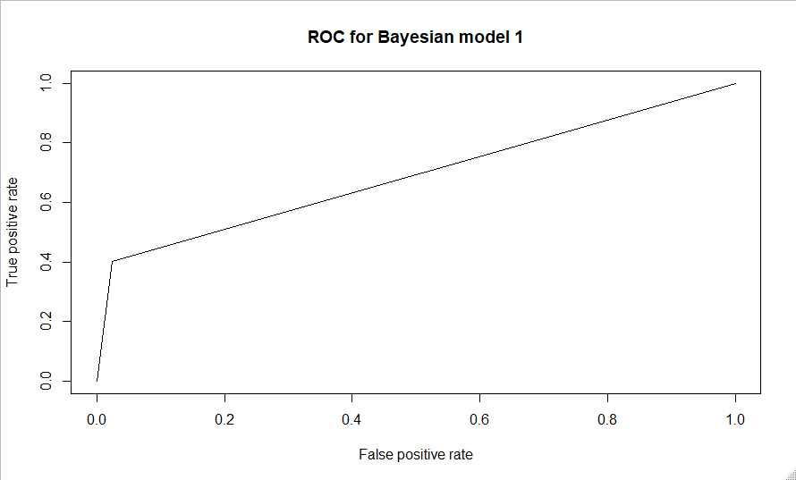
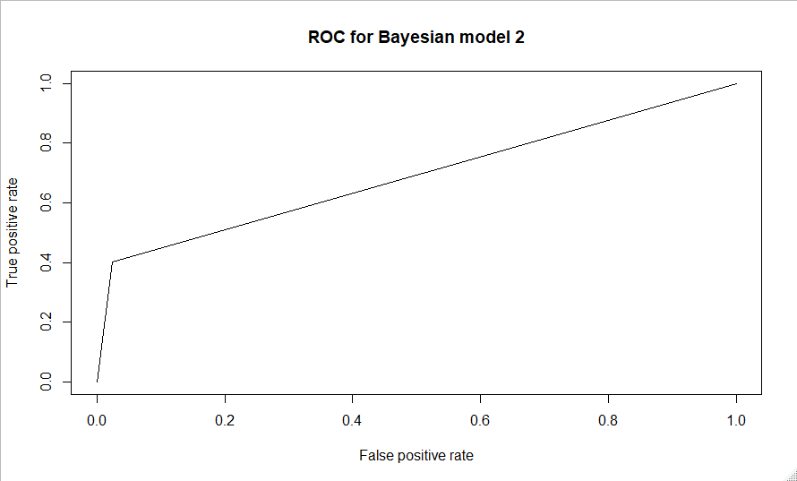
ROC plot of both models
AUC of model 1 = 0.6892
AUC of model 2 = 0.6893
Conclusion : -
From the above plot, we see that curve of the graph slightly straight to the top left corner indicating that true positive rate is not too high and false positive rate is not too low. And AUC of both curve are nearly same.

Slide 17
3) Random Forest
Statistics of Random Forest
Sensitivity | 0.897436
Specificity | 0.31579
Pos Pred Value | 0.729167
Neg Pred Value | 0.6
Precision | 0.729167
Recall | 0.897436
F1 | 0.804598
Prevalence | 0.672414
Detection Rate | 0.603448
Detection Prevalence | 0.827586
Balanced Accuracy | 0.606613
Accuracy | 0.706897
Conclusion : -
From the above table,
i) We see that the accuracy of this model is 70.69%.
ii) Precision is 0.7291 that indicates proportion of non liver patients that is correctly classified to the total no. of non liver predicted samples.
iii) Here Sensitivity(Recall) is 0.8537 that indicates proportion of non liver patients that were correctly classified to the total no. of non liver patients.
iv) Here specificity 0.3158 that indicates proportion of liver patients that were correctly classified to the total no. of liver patients.

Slide 18
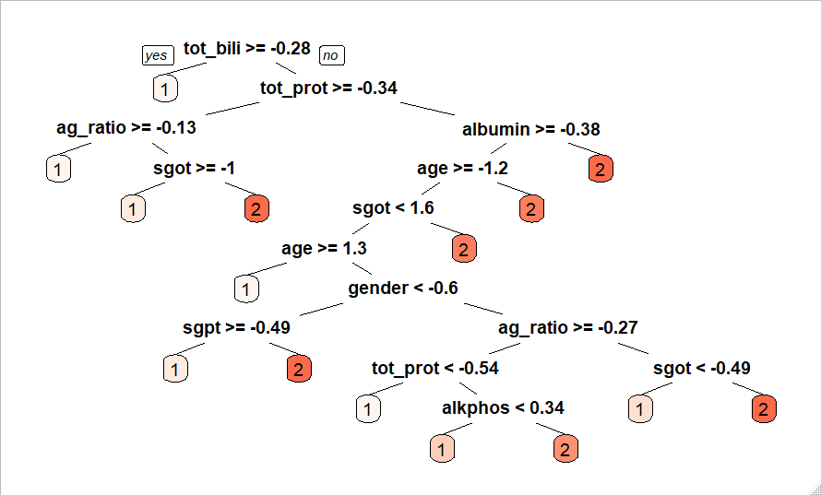
4) Decision Tree

Slide 19
Statistics of decision tree
Sensitivity | 1
Specificity | 0
Pos Pred Value | 0.672414
Neg Pred Value | NaN
Precision | 0.672414
Recall | 1
F1 | 0.804124
Prevalence | 0.672414
Detection Rate | 0.672414
Detection Prevalence | 1
Balanced Accuracy | 0.5
Accuracy | 0.672414
Conclusion : -
From the above table,
i) Precision is 0.6724 that indicates proportion of non liver patients that is correctly classified to the total no. of non liver predicted samples.
ii) Here Sensitivity(Recall) is 1 that indicates proportion of non liver patients that were correctly classified to the total no. of non liver patients.
iii) Here specificity 0 that indicates proportion of liver patients that were correctly classified to the total no. of liver patients.

Slide 20
5) K – NEAREST NEIBHOUR
Confusion Matrix and Statistics
For k=1
 | Reference
Prediction | 0 | 1
0 | 24 | 36
1 | 25 | 90
Conclusion : -
In the above confusion matrix, out of 175 observations there 24 out of 41 observations and 90 out of 134 observations are correctly classified.
Accuracy | 0.6514
95% CI | (0.5759, 0.7218)
No Information Rate | 0.72
P-Value [Acc > NIR] | 0.9807
Kappa | 0.191
Mcnemar’s Test P-Value | 0.2004
Sensitivity | 0.4898
Specificity | 0.7143
Pos Pred Value | 0.4
Neg Pred Value | 0.7826
Prevalence | 0.28
Detection Rate | 0.1371
Detection Prevalence | 0.3429
Balanced Accuracy | 0.602
‘Positive’ Class | 0
Conclusion : -
From the above table,
i) We see that the accuracy of this model is 65.14% and it may varies between (57.59%, 72.18%).
ii) Kappa value = 0.191 means this model fair (means we may use this model for future prediction).
iii) Here Sensitivity is 0.4898 that indicates proportion of non liver patients that were correctly classified to the total no. of non liver patients.
iv) Here specificity 0.7143 that indicates proportion of liver patients that were correctly classified to the total no. of liver patients.

Slide 21
Confusion Matrix and Statistics For k=3
 | Reference
Prediction | 0 | 1
0 | 20 | 31
1 | 29 | 95
Conclusion : -
In the above confusion matrix, out of 175 observations there 24 out of 41 observations and 90 out of 134 observations are correctly classified.
Accuracy | 0.6575
95% CI | (0.5817, 0.7271)
No Information Rate | 0.72
P-Value [Acc > NIR] | 0.9717
Kappa | 0.1601
Mcnemar’s Test P-Value | 0.8973
Sensitivity | 0.4082
Specificity | 0.7540
Pos Pred Value | 0.3922
Neg Pred Value | 0.7661
Prevalence | 0.28
Detection Rate | 0.1143
Detection Prevalence | 0.2914
Balanced Accuracy | 0.5811
‘Positive’ Class | 0
Conclusion : -
From the above table,
i) We see that the accuracy of this model is 65.75% and it may varies between (58.17%, 72.71%).
ii) Kappa value = 0.1601 means this model fair (means we may use this model for future prediction).
iii) Here Sensitivity is 0.4082 that indicates proportion of non liver patients that were correctly classified to the total no. of non liver patients.
iv) Here specificity 0.7540 that indicates proportion of liver patients that were correctly classified to the total no. of liver patients.

Slide 22
Confusion Matrix and Statistics For k=5
 | Reference
Prediction | 0 | 1
0 | 14 | 27
1 | 35 | 99
Conclusion : -
In the above confusion matrix, out of 175 observations there 40 out of 41 observations and 54 out of 134 observations are correctly classified.
Accuracy | 0.6457
95% CI | (0.57, 0.7164)
No Information Rate | 0.72
P-Value [Acc > NIR] | 0.9871
Kappa | 0.0752
Mcnemar’s Test P-Value | 0.3740
Sensitivity | 0.2857
Specificity | 0.7857
Pos Pred Value | 0.3415
Neg Pred Value | 0.7388
Prevalence | 0.28
Detection Rate | 0.08
Detection Prevalence | 0.2343
Balanced Accuracy | 0.5357
‘Positive’ Class | 0
Conclusion : -
From the above table,
i) We see that the accuracy of this model is 64.57% and it may varies between (55.24%, 70.03%).
ii) Kappa value = 0.0752 means this model fair (means we may use this model for future prediction).
iii) Here Sensitivity is 0.2857 that indicates proportion of non liver patients that were correctly classified to the total no. of non liver patients.
iv) Here specificity 0.7857 that indicates proportion of liver patients that were correctly classified to the total no. of liver patients.

Slide 23
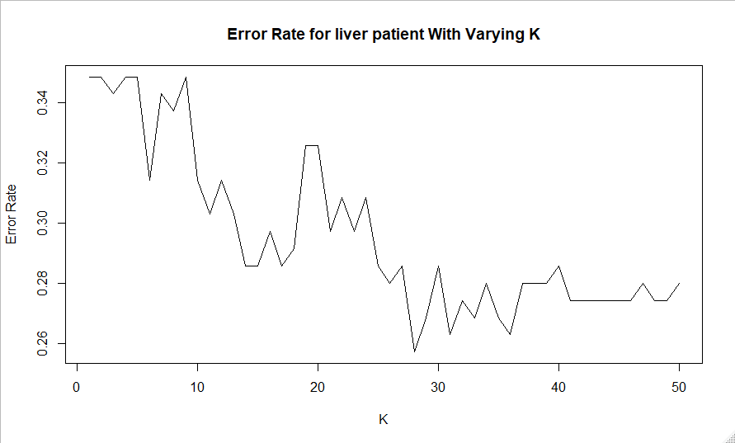
Error Rate Plot
Conclusion : -
In the above plot we see that, at k=28 the error rate is minimum.

Slide 24
Confusion Matrix and Statistics For k=28
 | Reference
Prediction | 0 | 1
0 | 6 | 3
1 | 43 | 123
Conclusion : -
In the above confusion matrix, out of 175 observations there 40 out of 41 observations and 54 out of 134 observations are correctly classified.
Accuracy | 0.7371
95% CI | (0.6654, 0.8007)
No Information Rate | 0.72
P-Value [Acc > NIR] | 0.3407
Kappa | 0.1314
Mcnemar’s Test P-Value | 8.192E-9
Sensitivity | 0.12245
Specificity | 0.98619
Pos Pred Value | 0.66667
Neg Pred Value | 0.74096
Prevalence | 0.28
Detection Rate | 0.03429
Detection Prevalence | 0.05143
Balanced Accuracy | 0.54932
‘Positive’ Class | 0
Conclusion : -
From the above table,
i) We see that the accuracy of this model is 73.71% and it may varies between (66.54%, 80.07%).
ii) Kappa value = 0.1314 means this model fair (means we may use this model for future prediction).
iii) Here Sensitivity is 0.12245 that indicates proportion of non liver patients that were correctly classified to the total no. of non liver patients.
iv) Here specificity 0.98619 that indicates proportion of liver patients that were correctly classified to the total no. of liver patients.

Slide 25
6) SUPPORT VECTOR MACHINE
C | Accuracy | Kappa
0.25 | 0.717568 | 0.435059
0.5 | 0.704341 | 0.408648
1 | 0.707195 | 0.41432
2 | 0.705394 | 0.410774
4 | 0.705413 | 0.41084
8 | 0.708335 | 0.416676
16 | 0.710624 | 0.42116
32 | 0.726687 | 0.453275
64 | 0.753457 | 0.506837
128 | 0.754061 | 0.508016
256 | 0.754569 | 0.509019
512 | 0.760747 | 0.521364
1024 | 0.774511 | 0.548902
2048 | 0.776139 | 0.552195
4096 | 0.791454 | 0.582858
8192 | 0.793168 | 0.586302
16384 | 0.788696 | 0.577332
32768 | 0.789252 | 0.578461
65536 | 0.789252 | 0.578461
131072 | 0.789252 | 0.578461
Support Vector Machines with Radial Basis Function Kernel
584 samples
10 predictor
2 classes: ‘0’, ‘1’
Pre-processing: centred (10), scaled (10)
Resampling: Cross-Validated (10 fold, repeated 3 times)
Summary of sample sizes: 526, 526, 526, 526, 524, 526, ...
Resampling results across tuning parameters:
Tuning parameter ‘sigma’ was held constant at a value of 0.1623896
The final values used for the model were sigma = 0.1623896 and
C = 8192.

Slide 26
Confusion Matrix and Statistics
 | Reference
Prediction | 0 | 1
0 | 112 | 20
1 | 12 | 104
Conclusion : -
In the above confusion matrix, out of 175 observations there 40 out of 41 observations and 54 out of 134 observations are correctly classified.
Accuracy | 0.871
95% CI | (0.8228, 0.91)
No Information Rate | 0.5
P-Value [Acc > NIR] | <2e-16
Kappa | 0.7419
Mcnemar’s Test P-Value | 0.2159
Sensitivity | 0.9032
Specificity | 0.8387
Pos Pred Value | 0.8485
Neg Pred Value | 0.8966
Prevalence | 0.5
Detection Rate | 0.4516
Detection Prevalence | 0.5323
Balanced Accuracy | 0.871
‘Positive’ Class | 0
Conclusion : -
From the above table,
i) We see that the accuracy of this model is 87.1% and it may varies between (82.28%, 91%).
ii) Kappa value = 0.7419 means this model fair(means we may use this model for future prediction).
iii) Here Sensitivity is 0.9032 that indicates proportion of non liver patients that were correctly classified to the total no. of non liver patients.
iv) Here specificity 0.8387 that indicates proportion of liver patients that were correctly classified to the total no. of liver patients.

Slide 27
Comparative study of different predictive methods
 | Methods | accuracy(in %)
Logistic Regression | LR(M1) | 62.86
 | LR(M2) | 68
Naïve Bayes Classifier | NBC(M1) | 53.71
 | NBC(M2) | 54.86
Random Forest | RF | 70.6897
Decision Tree | DT | 67.2414
K-Nearest Neighbour | KNN(K=1) | 65.14
 | KNN(K=3) | 65.75
 | KNN(K=5) | 64.57
 | KNN(K=28) | 73.71
Support Vector Machine | SVM | 87.1

Slide 28
Diagrammatic representation Comparative study of different predictive methods

Slide 29
Final Conclusion : -
In this project I used 6 classification methods, and all methods give good predictive model. Out of them support vector machine give us a best prediction model for a liver disease with accuracy 87.1%. and then second high accuracy of a method is K-Nearest Neighbours which gives 73.71% accuracy. And kappa value of all the methods are greater than 0, indicating that all the methods are good in prediction.
the highest kappa value is 0.7419 of a method Support Vector Machine.
Form all the classification methods the Support Vector Machine (SVM) is
best for predicting the liver disease.

Slide 30
REFERENCE
[1] “ Prediction and Analysis of Liver Disorder Diseases by using Data Mining Technique: Survey” from International Journal of Pure and Applied Mathematics. Volume 118 No. 9 2018, 765-770.
[2] “LIVER DISEASE PREDICTION BY USING DIFFERENT DECISION TREE TECHNIQUES” from International Journal of Data Mining & Knowledge Management Process (IJDKP) Vol.8, No.2, March 2018.
[3] “Early Detection of the Liver Disorder from Imbalance Liver Function Test Datasets” from International Journal of Innovative Technology and Exploring Engineering (IJITEE) ISSN: 2278-3075, Volume-8 Issue-4, February 2019.
[4] “An introduction to data cleaning with R” from Publisher Statistics Netherlands Henri Faasdreef 312, 2492 JP The Hague.
[5] “Liver Disease Prediction using SVM and Naïve Bayes Algorithms” from International Journal of Science, Engineering and Technology Research (IJSETR) Volume 4, Issue 4, April 2015.

Slide 31
[6] “Performance Analysis of Liver Disease Prediction Using Machine Learning Algorithms” from International Research Journal of Engineering and Technology (IRJET), Volume: 05 Issue: 01 | Jan-2018.
[7] “An Introduction to Statistical Learning with Applications in R” of springer. authors are Gareth James • Daniela Witten • Trevor Hastie Robert Tibshirani.
STATISTICAL SOFTWARE USE IN THS PROJECT : -
1) R-Studio
2) Excel stat
3) Ms-Excel.

Slide 32
THANK YOU !

